Slide 1
Lab2 Supervised Classification

Slide 2
Join the Kaggle competition
Create Kaggle account first
Competition URL:
https://www.kaggle.com/t/fbd9f9f03b644bd2b63f8e291951a545

Slide 3
Outline
Dataset
Lab2 overview

Slide 4

Dataset – Back Pain Classification
12 Features
Col1: pelvic_incidence
Col2: pelvic tilt
Col3: lumbar_lordosis_angle
Col4: sacral_slope
Col5: pelvic_radius
Col6: degree_spondylolisthesis
Col7: pelvic_slope
Col8: Direct_tilt
Col9: thoracic_slope
Col10: cervical_tilt
Col11: sacrum_angle
Col12: scoliosis_slope

Slide 5
Dataset – Back Pain Classification
Target:
Class
0: Normal
1: Abnormal
Training data
248 rows
Testing data
62 rows
Download data from Kaggle

Slide 6
Lab2 overview
Task: Supervised Classification
Dataset: Back Pain dataset
Given input features, you should classify the person has back pain or not
You can use any typical ML classification method to do this homework(Naive Bayes, Decision Tree, Logistic Regression, K-Nearest Neighbors, Support Vector Machine, etc.)
Note: You should write the classifier by yourself
Can not use scikit-learn

Slide 7
Some tips
Data preprocessing
Normalization
Delete some unimportant features
Validation
Spilt the training data into train and val
Holdout validation
K-Fold Cross Validation
If you have no idea which classifier to use, you can use logistic regression(simple to implement but not the best one)

Slide 8



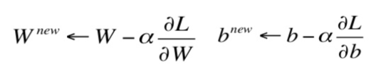

Logistic regression
Similar to linear regression(Lab0)
Different loss
You have to calculate $\frac{∂L}{∂W},\frac{∂L}{∂b}$by yourself

Slide 9
Upload to Kaggle
Write file
Write the prediction to csv file (ID_result.csv)
Evaluation
Categorization accuracy
Upload to Kaggle

Slide 10
Assignment Regulation
You can use jupyter notebook(.ipynb) or Python script(.py)
You don’t need to use GPU in this lab
Package available
numpy
pandas
Scikit-learn
Don’t cheat and don’t guess the answer by yourself
I will run your code

Slide 11
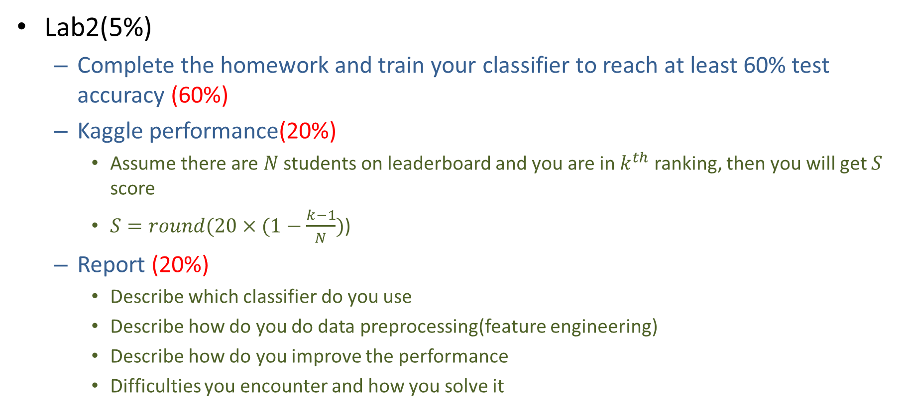
Lab2 Gading policy
Lab2(5%)
Complete the homework and train your classifier to reach at least 60% test accuracy (60%)
Kaggle performance(20%)
Assume there are $N$ students on leaderboard and you are in $k^{th}$ ranking, then you will get $S$ score
$S=round(20×(1−\frac{k−1}{N})$)
Report (20%)
Describe which classifier do you use
Describe how do you do data preprocessing(feature engineering)
Describe how do you improve the performance
Difficulties you encounter and how you solve it

Slide 12
Reminder
Submit Deadline : 2 week (04/17/2020 11:59 PM)
You need to submit your code to New E3 and upload the result to Kaggle
Hand in your files to new e3
Your code
Readme.txt
Simply explain how to run your code
StudentID_report.pdf

Slide 13
Notice!!!
Change your team name to your ID
If TA can not find your ID, you will loss 20% of score in this lab directly
You only have 10 times maximum daily submissions

Slide 14
Shut down your kernel !!!!!
Remember to SHUTDOWN the kernel
To release resources for others.

